Slide 1
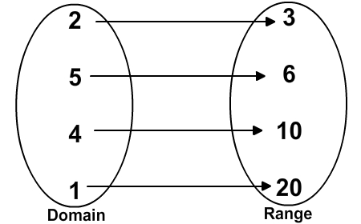
Is it a Function?
Do any x-values repeat?
Yes No
Do they have different y-values?
Do they have the same y-values?
Function
Non- Function
Function
(3,7) (4,1) (6,2) (5,8) (4,10)
X | 0 | 1 | 2 | 3 | 2
Y | 4 | 5 | 6 | 7 | 6

